Slide 1
WEATHER DATA ANALYSIS AND PREDICTION
A Comprehensive Project Presentation
Historical Data • Time-Series Analysis • Regression & ML Models • Forecasting
Academic Year 2026 – 2027

Slide 2

STUDENT DETAILS
Student Name:
ROHIT KURUP
Roll Number:
25SCS1003001209
Course / Branch:
B.Tech / AIML
Semester / Year:
3RD / 2ND
Section:
2CSE-2
Institution:
IILM UNIVERSITY

Slide 3
AGENDA
01
Introduction & Problem Statement
02
Weather Data Landscape & Sources
03
System Architecture & Design
04
Core Features & Modules
05
Technology Stack
06
Challenges, SWOT & Future Trends
07
Conclusion & Recommendations

Slide 4
INTRODUCTION
What is a Weather Data Analysis and Prediction System?
A data pipeline that collects historical weather observations from multiple sources, cleans and analyses them for trends and seasonality, and applies regression and time-series models to forecast future temperature and related conditions.
Data Sources
Analysis Engine
End Users
Ground stations, satellites & radar
Public weather APIs (NOAA/IMD)
Historical CSV/open datasets
Cleaning & feature engineering
Regression, ARIMA & LSTM models
Accuracy evaluation (RMSE/MAE)
Researchers & planners
Farmers & agriculture teams
Aviation & disaster-management

Slide 5
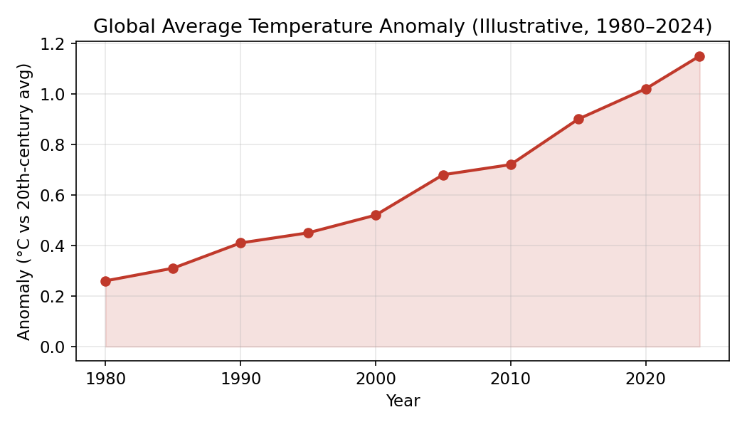
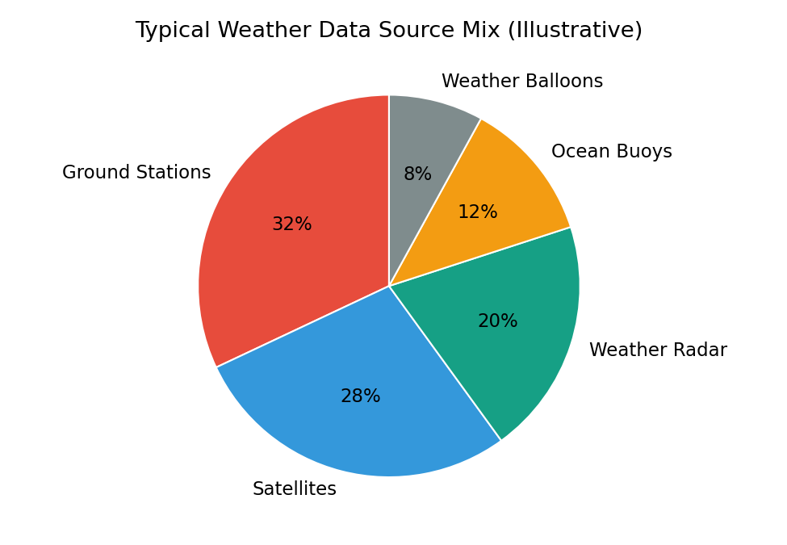
WEATHER DATA LANDSCAPE
80+ yrs
1.15°C
5+
Daily
Typical Historical
Record Span
Illustrative Temp.
Anomaly (2024)
Major Weather
Data Source Types
Typical Data
Refresh Cadence

Slide 6
MODELLING APPROACHES
Two complementary families of prediction techniques
REGRESSION-BASED MODELS
TIME-SERIES & DEEP LEARNING
Linear & polynomial regression
Highly interpretable and fast to train
Best suited for smooth, long-term trends
Simple baseline before complex models
ARIMA / SARIMA and LSTM networks
Captures seasonality & non-linear patterns
Needs more data, tuning & compute
Typically stronger short/medium-term accuracy

Slide 7
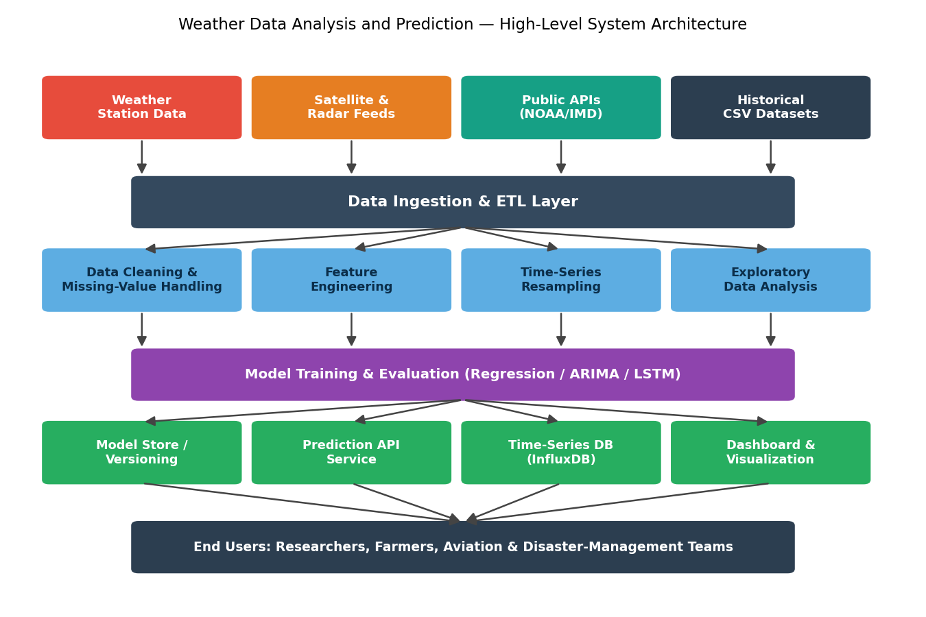
SYSTEM ARCHITECTURE

Slide 8
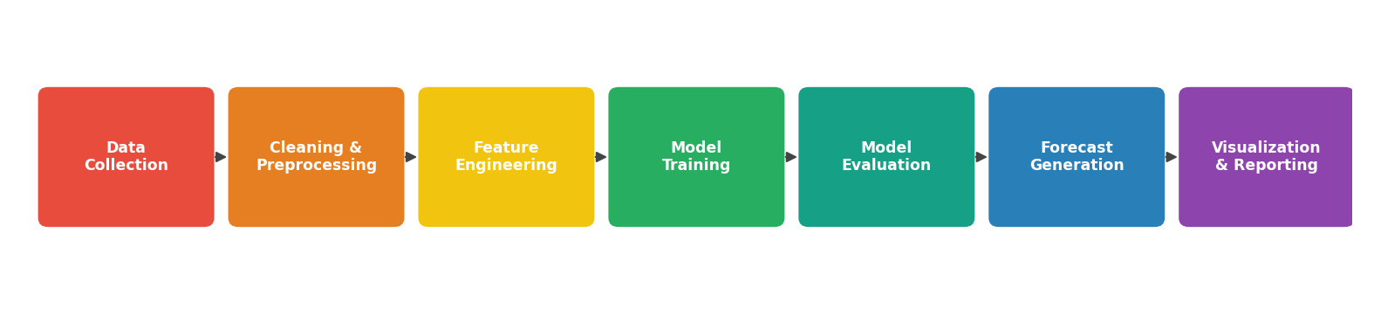
DATA PIPELINE & CORE FEATURES
Collection
Cleaning
Feature Engg.
Multi-source ingestion (stations, APIs, satellites)
Missing-value handling & outlier detection
Lag values, rolling averages, seasonal features
Modelling
Evaluation
Visualization
Regression, ARIMA & LSTM model training
RMSE, MAE & R² on held-out test data
Trend, forecast & accuracy dashboards

Slide 9
TECHNOLOGY STACK
Data & Modelling
Backend & Serving
Storage
Infra & Tools
Python
Pandas / NumPy
scikit-learn
statsmodels
TensorFlow / Keras
Flask / FastAPI
REST APIs
Apache Airflow
Scheduled retraining
CSV / Parquet files
InfluxDB / TimescaleDB
PostgreSQL / SQLite
Jupyter / Colab
Git version control
Streamlit dashboards
Docker

Slide 10
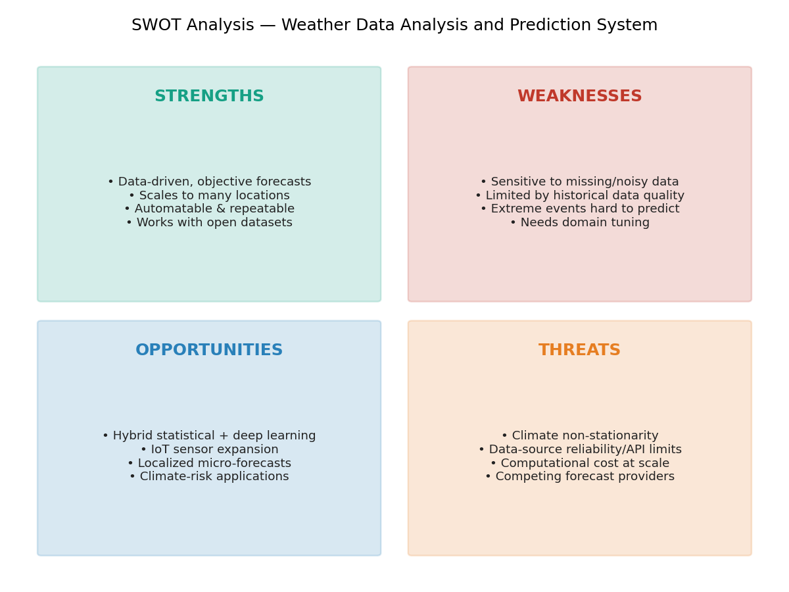
CHALLENGES & SWOT HIGHLIGHTS
Key Challenges
Missing / noisy sensor data
Non-stationary climate patterns
Rare extreme-event prediction
Overfitting on small datasets
Third-party API dependency
Need for periodic retraining

Slide 11
FUTURE TRENDS & OPPORTUNITIES
Hybrid Models
IoT Sensor Growth
Micro-Forecasting
Combining regression/ARIMA with deep learning
Low-cost sensors enabling denser data
Highly localized, street-level predictions
Climate-Risk Apps
Explainable Forecasts
Cloud & Edge Deploy.
Crop planning, energy & disaster warnings
Uncertainty-aware, trustworthy predictions
Scalable retraining & real-time serving

Slide 12
CONCLUSION & RECOMMENDATIONS
Key Takeaways
Weather data analysis combines multi-source historical data with time-series and regression techniques to forecast future conditions.
Thorough data cleaning and exploratory analysis matter as much as model choice, since weather data is noisy and irregularly sampled.
Regression and ARIMA provide strong, interpretable baselines; LSTM improves accuracy when sufficient historical data exists.
A modular pipeline — ingestion, preprocessing, modelling, evaluation and visualization — is reusable across locations and parameters.
Thank You
Questions & Discussion Welcome

